Slide 1

NASDAQ 100 Trend Classification: Machine Learning's Approach to Identifying Major Turning Points

Slide 2

Introduction/Problem Statement
In this case study, we aimed at designing and implementing a classification model that uses broad economic and leading market indicators to forecast significant peaks and valleys in the NASDAQ 100 index from 2007 to 2023. Our primary goal is to determine the relationship between these indicators and the market's major turning points, providing valuable insights for investors.
Key Question: Can we accurately predict the market's major turning points using public economic and market data?

Slide 3
Context
Importance of Predicting Major Peaks and Valleys: Predicting significant peaks and valleys in stock market indices allows investors and financial institutions to make informed decisions. By anticipating market shifts, they can optimize their investment strategies, reduce risks, and potentially secure higher returns.
Overview of Objectives:
Analyse historical data from 2007 to 2023.
Identify relevant economic and leading market indicators.
Design and implement a classification model.
Evaluate the model's accuracy in forecasting major turning points in the NASDAQ 100 index.

Slide 4
Dataset Description
To address the problem at hand, we've curated a comprehensive dataset that draws from reputable financial sources. This dataset amalgamates historical prices, trade volumes, and key economic metrics which will serve as the foundation for our model.
Description of data sources: Yahoo Finance for historical NASDAQ 100 data, NASDAQ for S&P PE Ratio, and FRED for various economic indicators.
Time range of collected data: 2007-01-01 to 2023-08-10.
Types of data: Daily adjusted closing prices, economic indicators like GDP, consumer price index, etc.

Slide 5
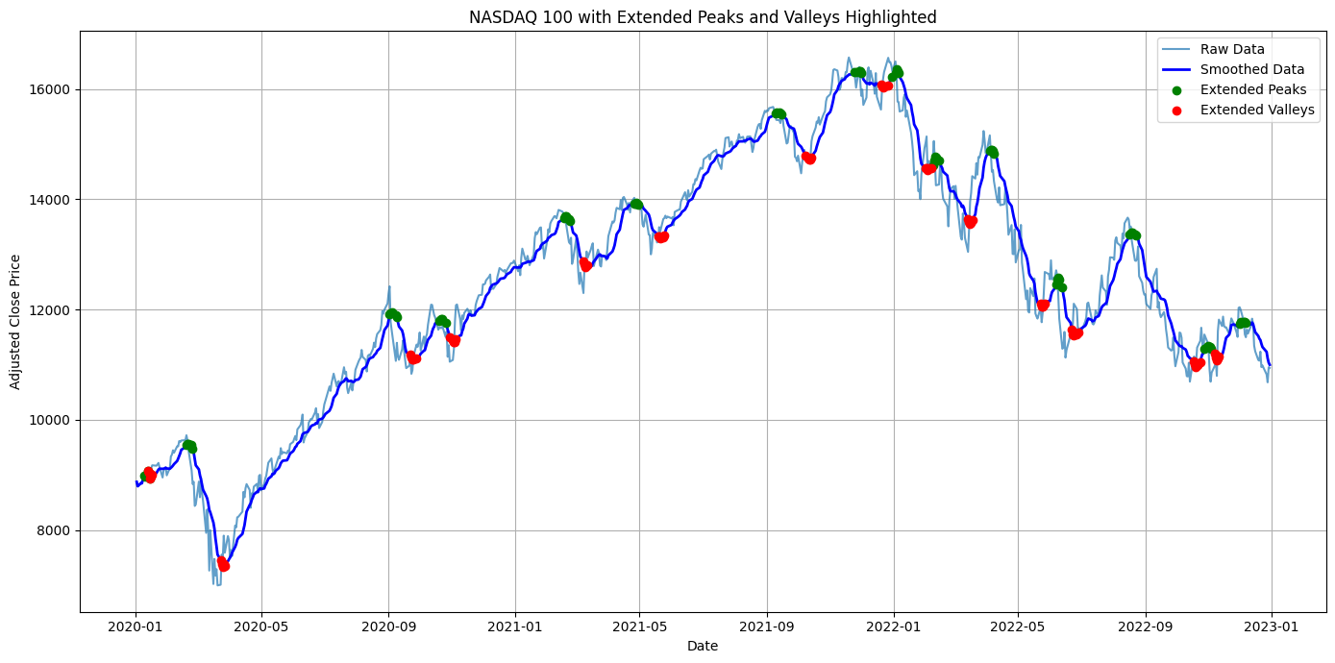
Data Wrangling and Pre-processing
The necessity of data merging and alignment across different financial sources.
Techniques and challenges in data cleaning, such as handling missing values and anomalies.
The importance of data smoothing and normalization in preparing data for machine learning algorithms.

Slide 6
Exploratory Analysis
Merging data using NASDAQ dates.
Removing redundant columns for clarity.
Dataset contains 4,179 entries and 27 columns.
Handling missing data using interpolation.
Feature Engineering:
Introduction of 'Buffet_ind' as a market valuation indicator.
Yield curve slopes ('10Y-2Y Slope' and '10Y-3M Slope') to gauge economic trends.
Rationale behind these engineered features in the context of financial analysis.

Slide 7
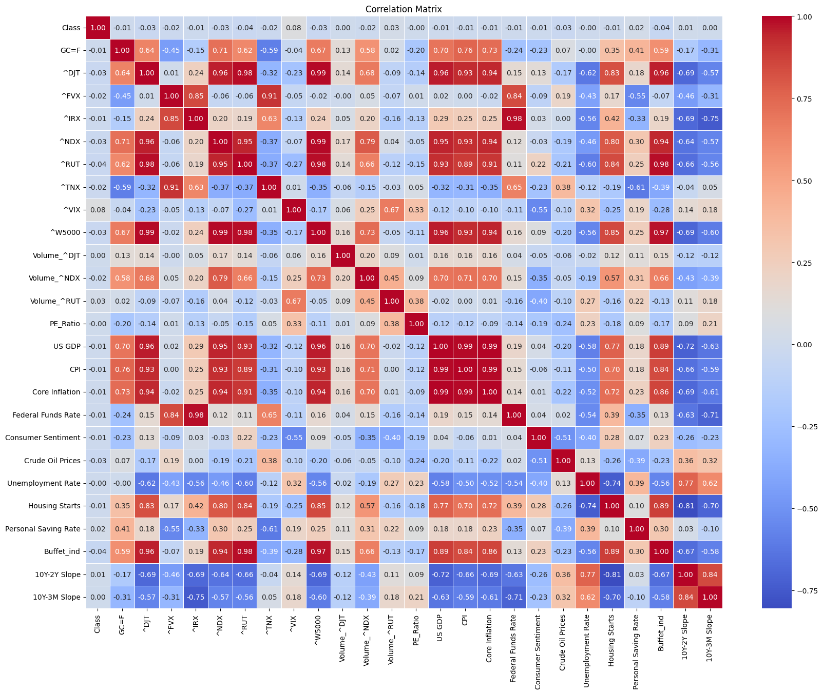
Exploratory Analysis - Correlations
Highlighting key correlations: ^VIX's relationship with market peaks/valleys.
Negative correlation of 'Buffet_ind' with target, indicating its predictive power.
Insights from yield curve analysis: Implications for economic forecasting.

Slide 8
Modelling - Selection and Pre-processing
Rationale for choosing LSTM and GBT models: Suitability for time-series prediction.
Pre-processing steps: Normalization with MinMaxScaler, Class imbalance handling with SMOTE, and transformation into time series sequences.

Slide 9
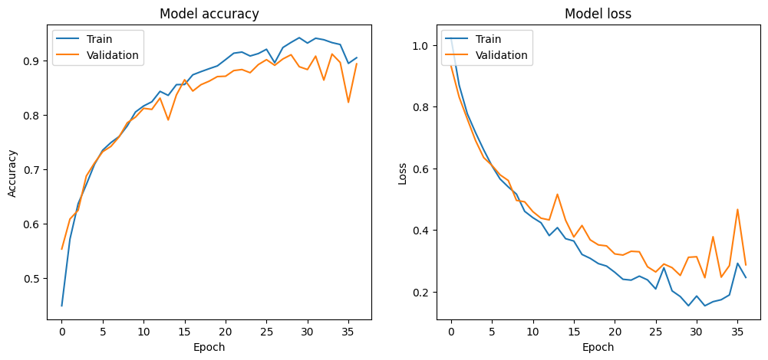
LSTM Model Configuration
Detailed architecture of LSTM model: Three LSTM layers followed by a dense layer.
Training strategy: Use of early stopping and learning rate reduction to prevent overfitting and enhance learning.

Slide 10
Model Performance Analysis
Quantitative performance: Accuracy of ~92.09% on the test set.
Qualitative analysis: Tendency to predict class 2 more frequently, challenges in predicting classes 1 and 3.

Slide 11
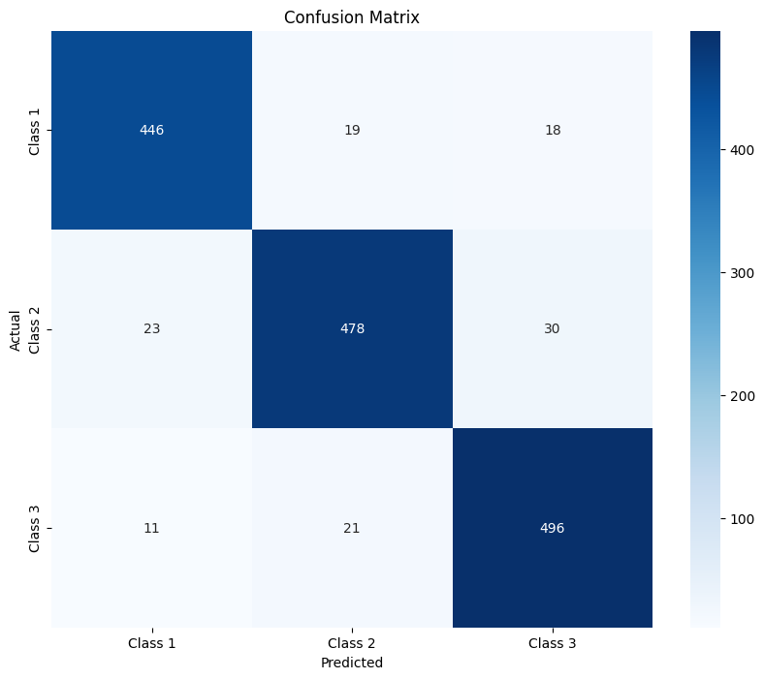
In-depth Model Evaluation
Analysis of the confusion matrix: Performance breakdown by class.
Training dynamics: Improvement across epochs, effective stopping at the 37th epoch.

Slide 12
Conclusions
LSTM's superior performance with 92% accuracy.
Significance of SMOTE in pre-processing.
Achieved objective: predicting peaks and valleys in NASDAQ 100.

Slide 13
Recommendations for Improvement
Hyperparameter tuning.
Trying different optimizers.
Exploring ensemble methods.
Parameter engineering insights.
Investigating feature characteristics.

Slide 14
Further Research
Hyperparameter optimization techniques.
Exploration of deep learning architectures.
Importance & engineering of features.
Alternate resampling techniques.
Diving deeper into misclassified instances.
Expanding the dataset with more diverse economic indicators.
Collaborative efforts with data scientists and financial analysts for enriched perspectives.

